Slide 1
Auto Diagram
Chen Dar, Karin Yechilzuke, and Ahmad Khalila
https://github.com/darc1/auto-diagram

Slide 2
Use examples of our tool were prompted as follows
Text + Pcap
Text + Paper
Text + Paper + pcap
Compare with original

Slide 3
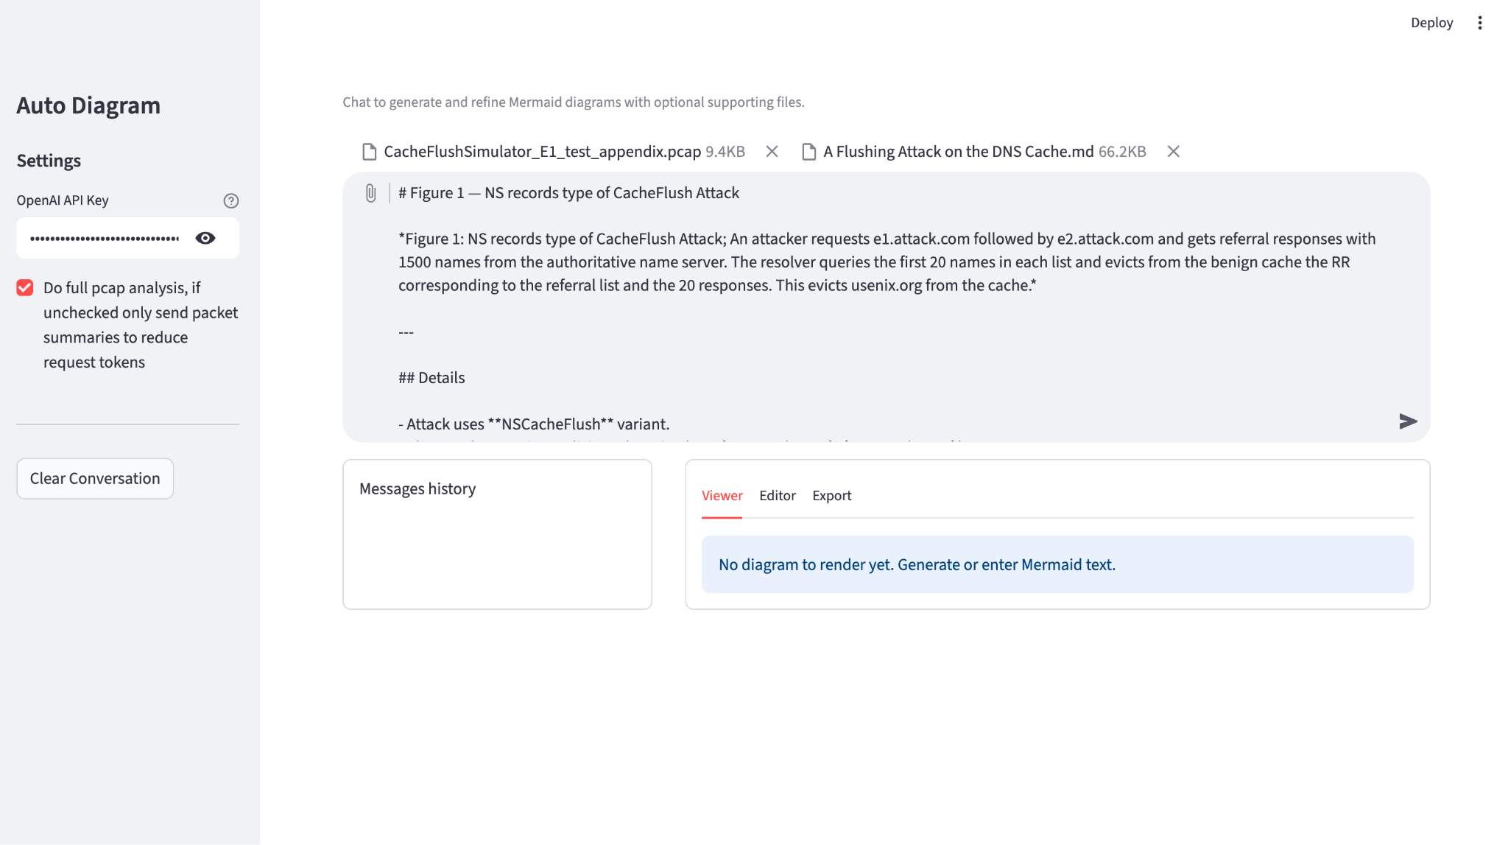
Auto-diagram - Input & Analysis
Support multiple file types:.pcap, text, md and images.
Multiple pcap analysis options - for reduced costs.
Core engine creates a context for mermaid diagram generation.

Slide 4
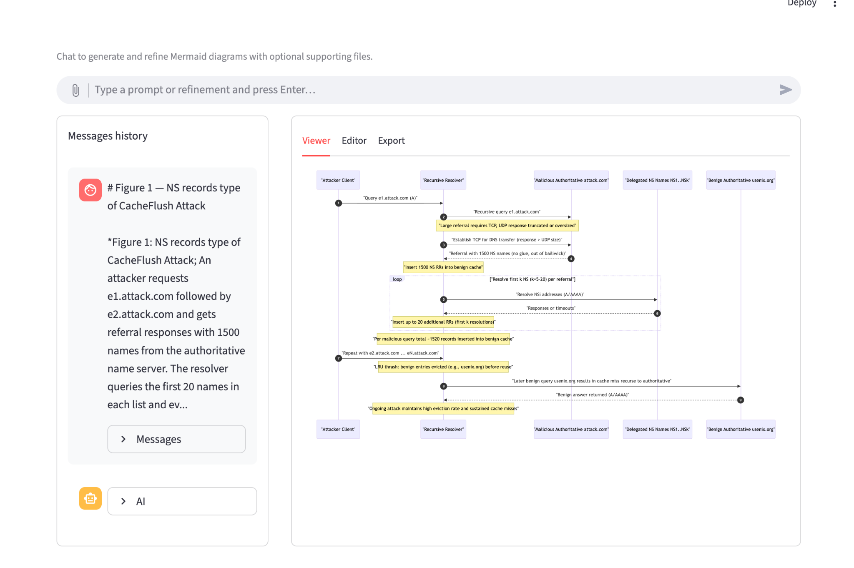
Auto-diagram - Diagram Generation & Presentation
Interactive storyboard, allowing quick edits, re-runs, and export.
Feedback loop: user adjusts parameters, reruns analyze → render cycle to refine narratives for slides or reports.

Slide 5
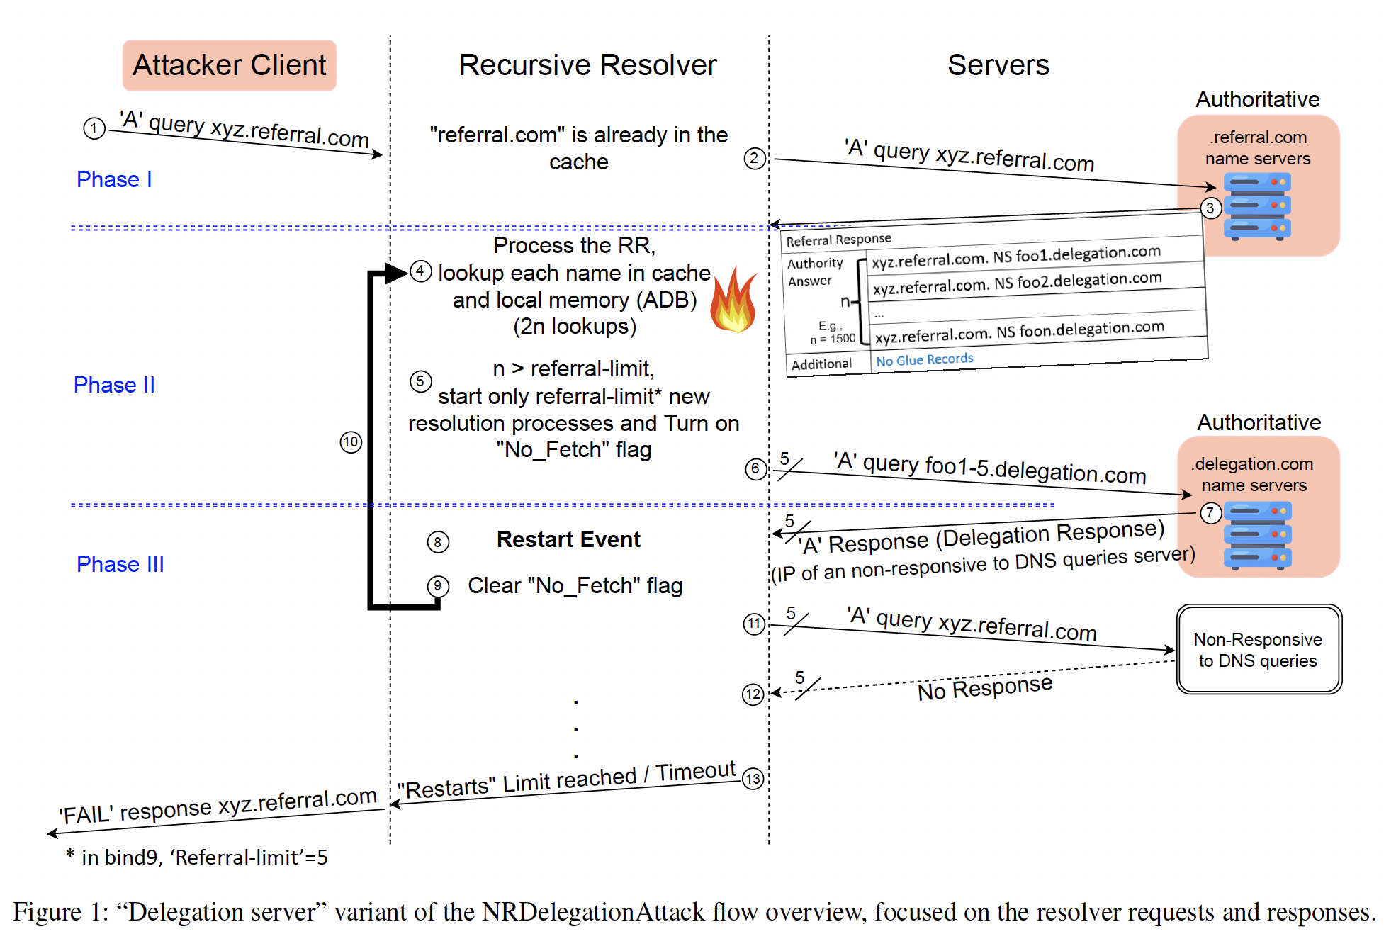
Example 1: NRDelegation Attack
We simulated the attack presented in Figure 1, and captured a pcap for our use.

Slide 6
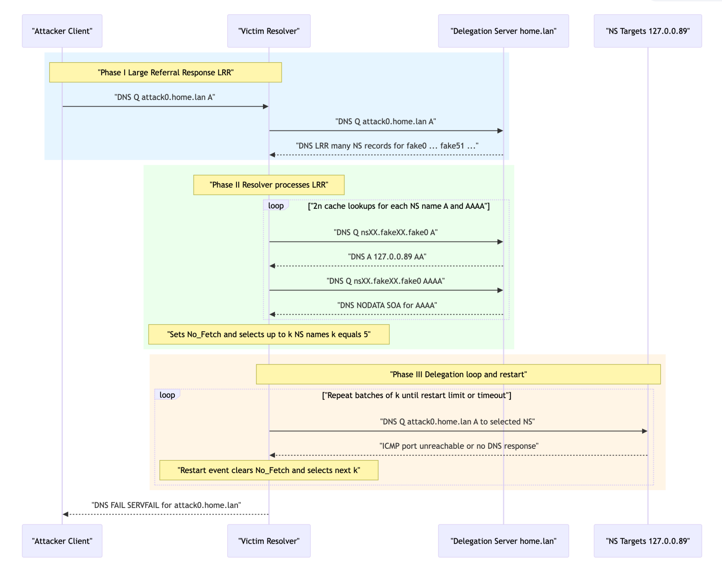
Example 1: Prompt + Pcap

Slide 7
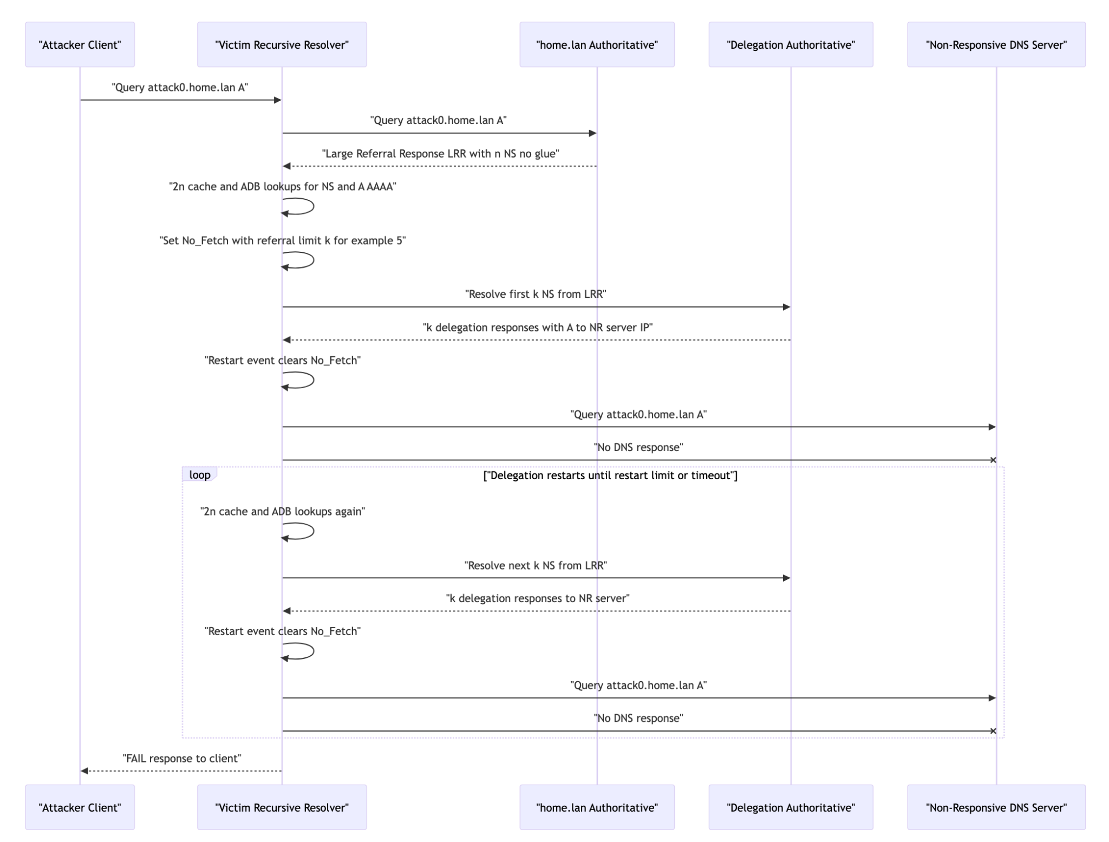
Example 1: Prompt + Paper

Slide 8
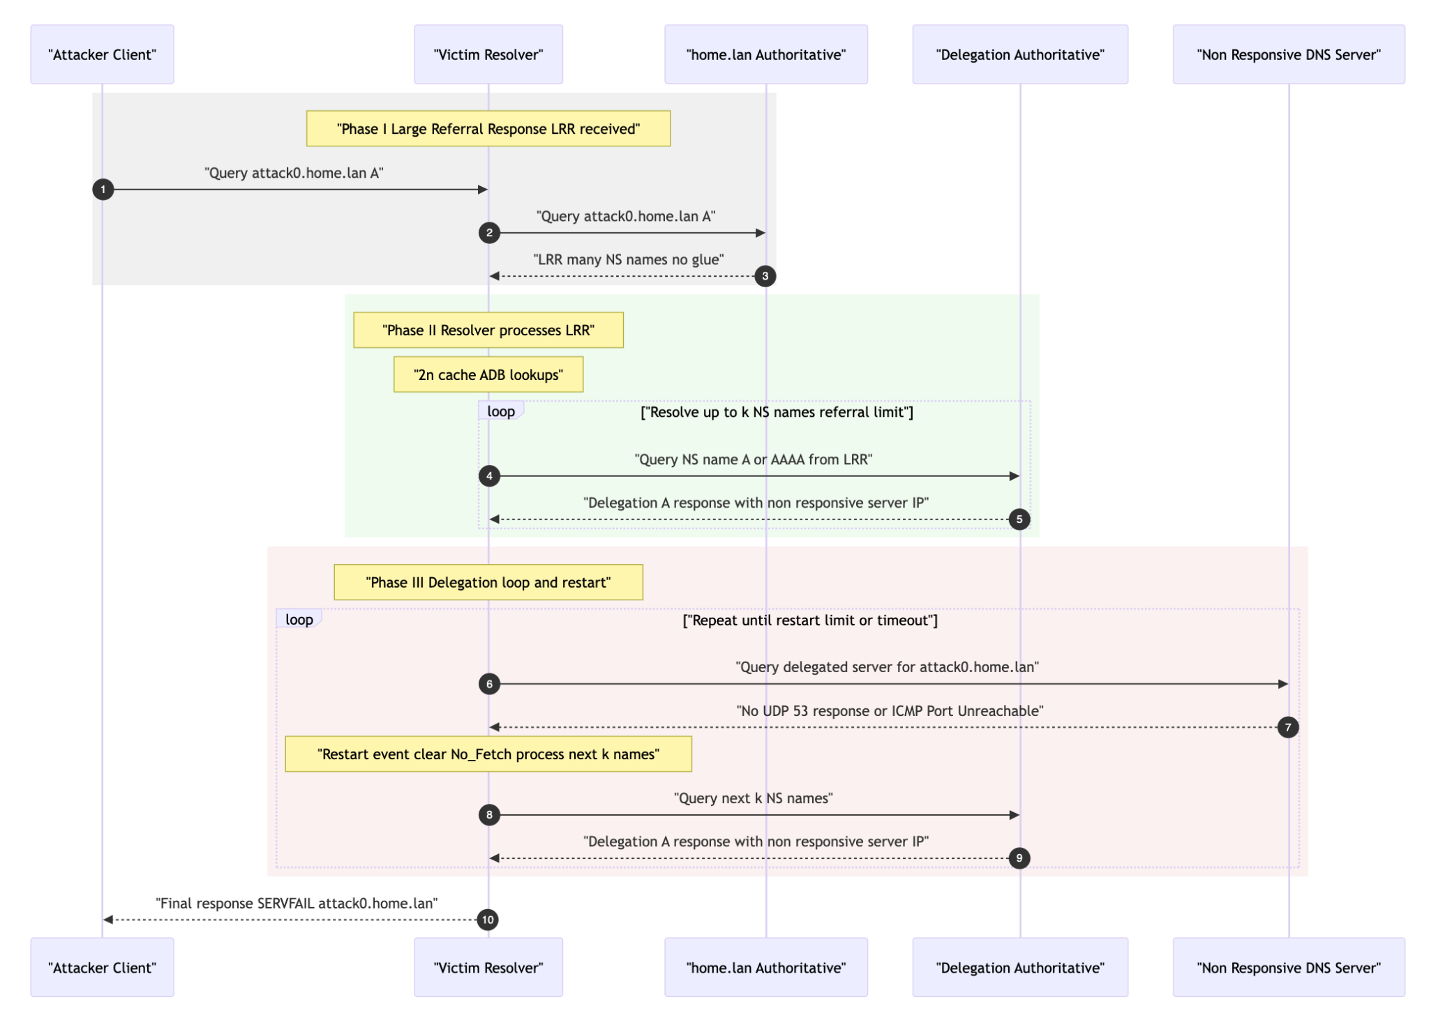
Example 1: Prompt + Paper + Pcap

Slide 9
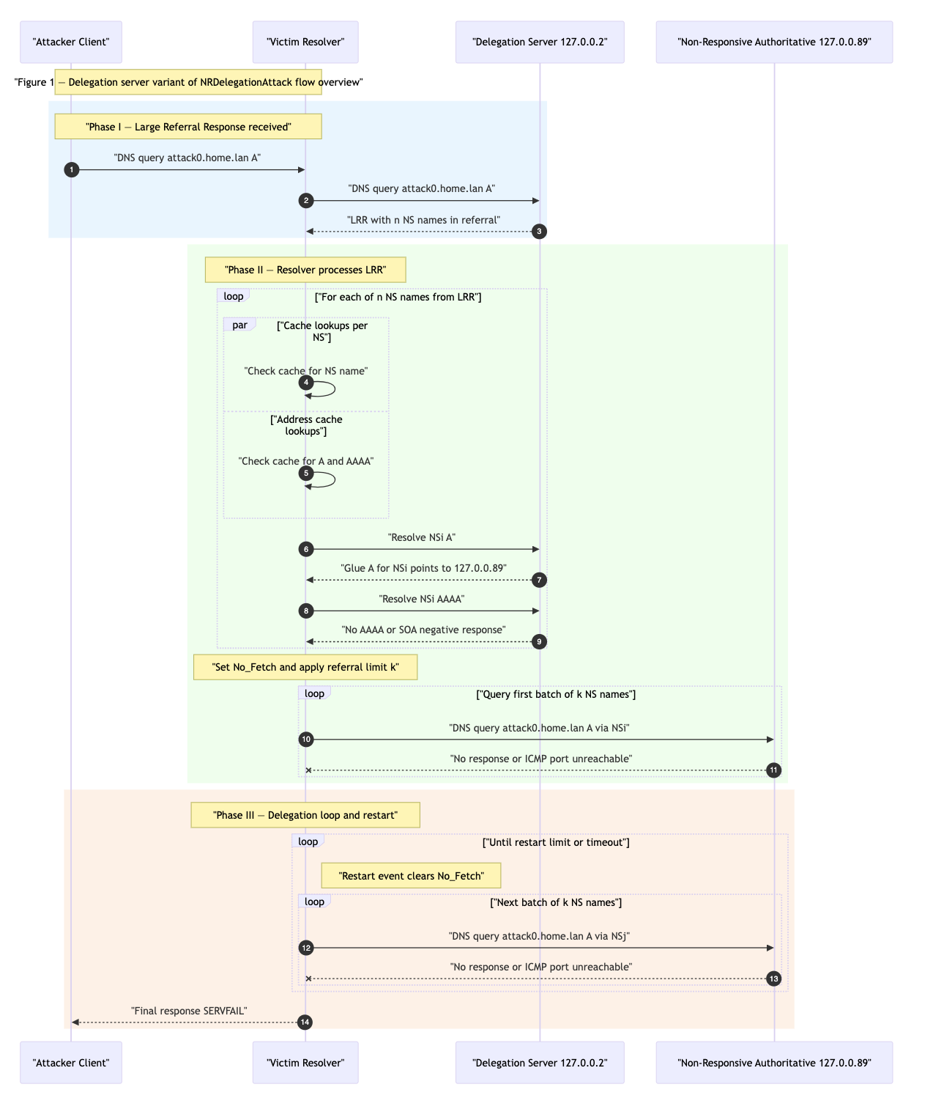
Example 1 Updated*: Prompt + Pcap

Slide 10
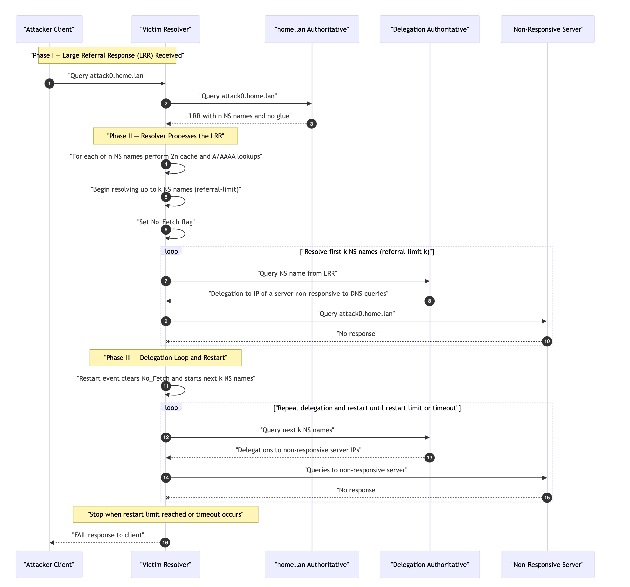
Example 1 Updated*: Prompt + Paper

Slide 11
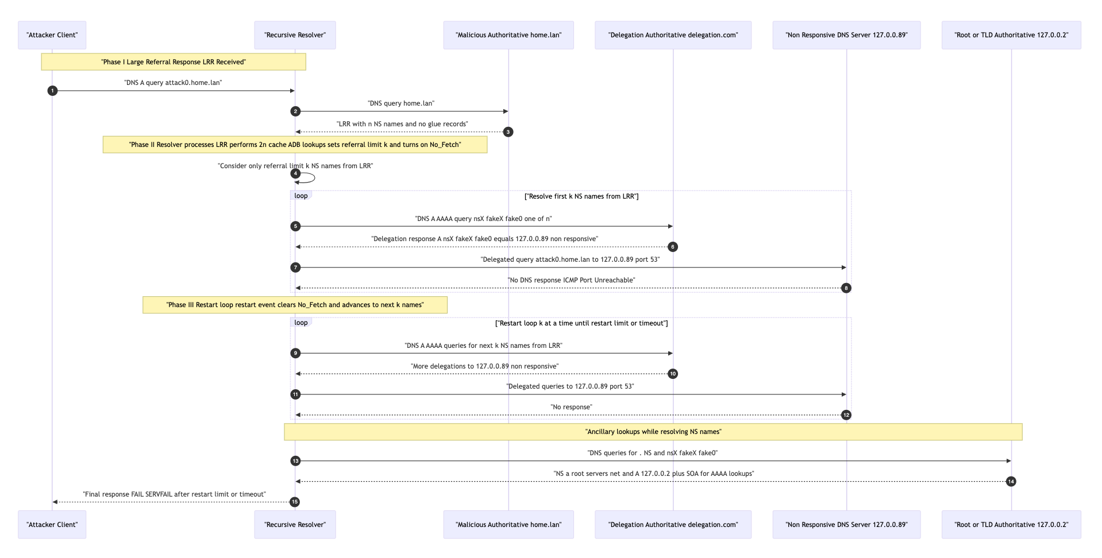
Example 1Updated*: Prompt + Paper + Pcap

Slide 12
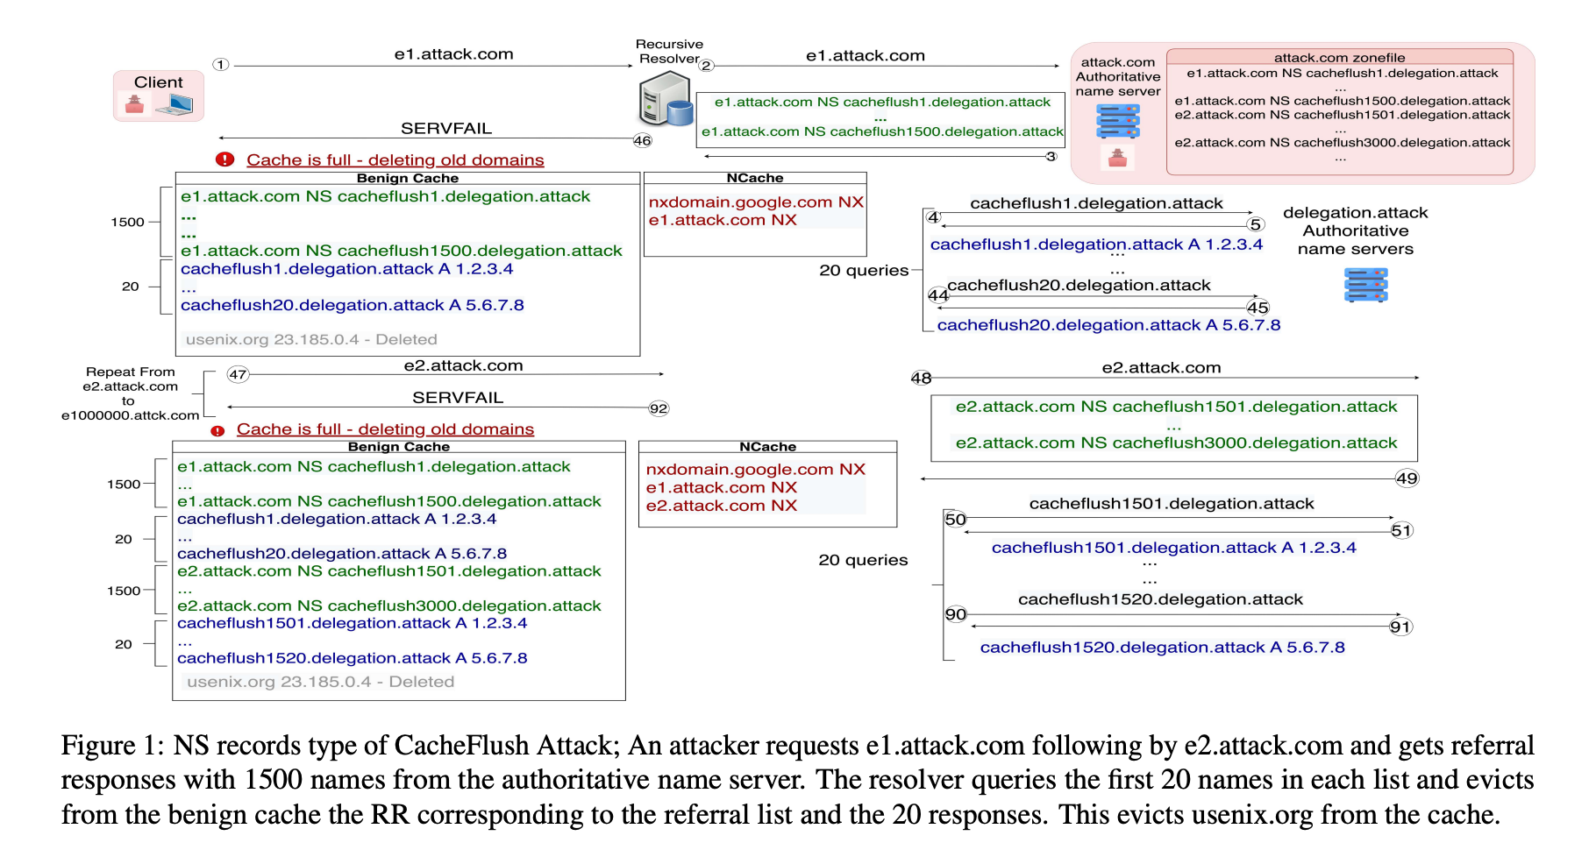
Example 2a: A Flushing Attack on the DNS Cache - Fig 1

Slide 13
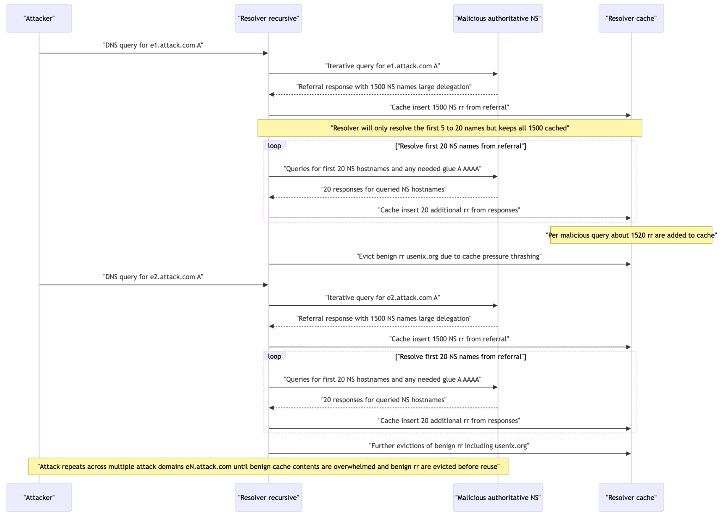
Example 2a: Prompt + Pcap

Slide 14
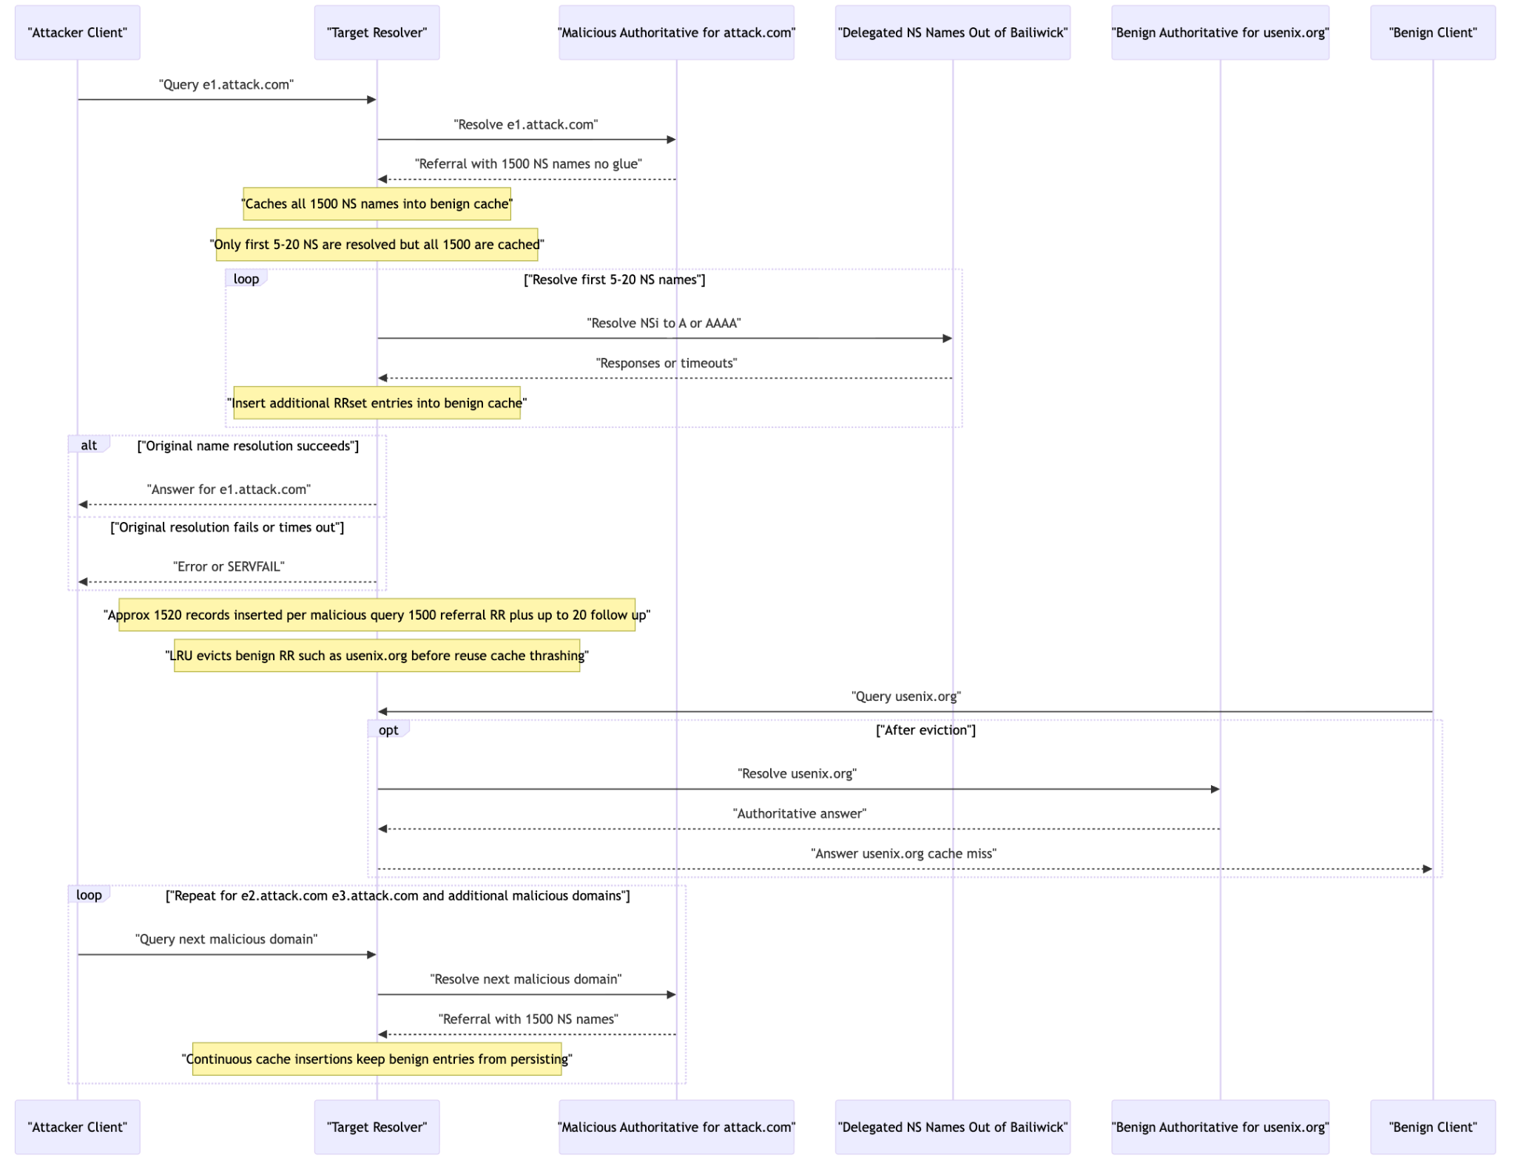
Example 2a: Prompt + Paper

Slide 15
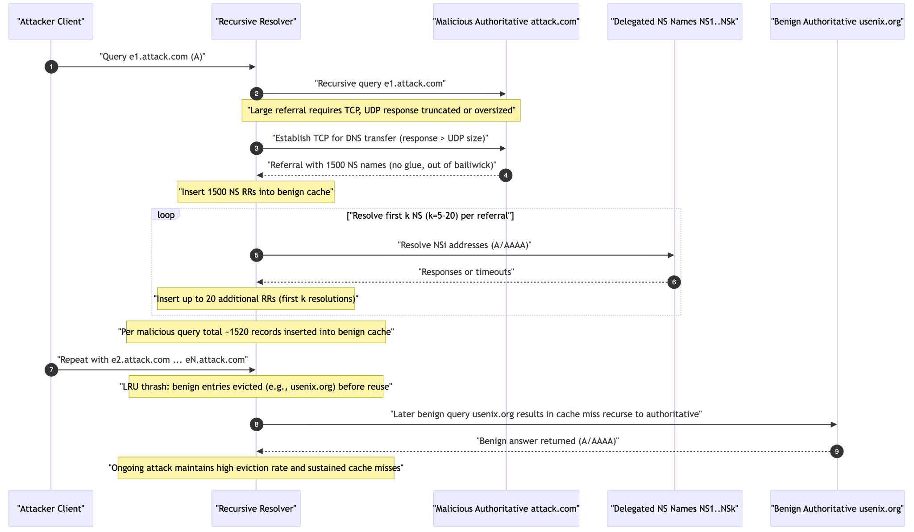
Example 2a: Prompt + Pcap + Paper

Slide 16
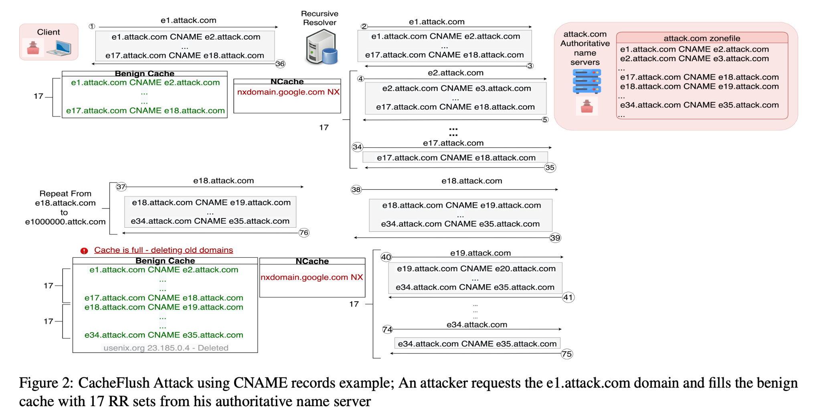
Example 2b: A Flushing Attack on the DNS Cache - Fig 2

Slide 17
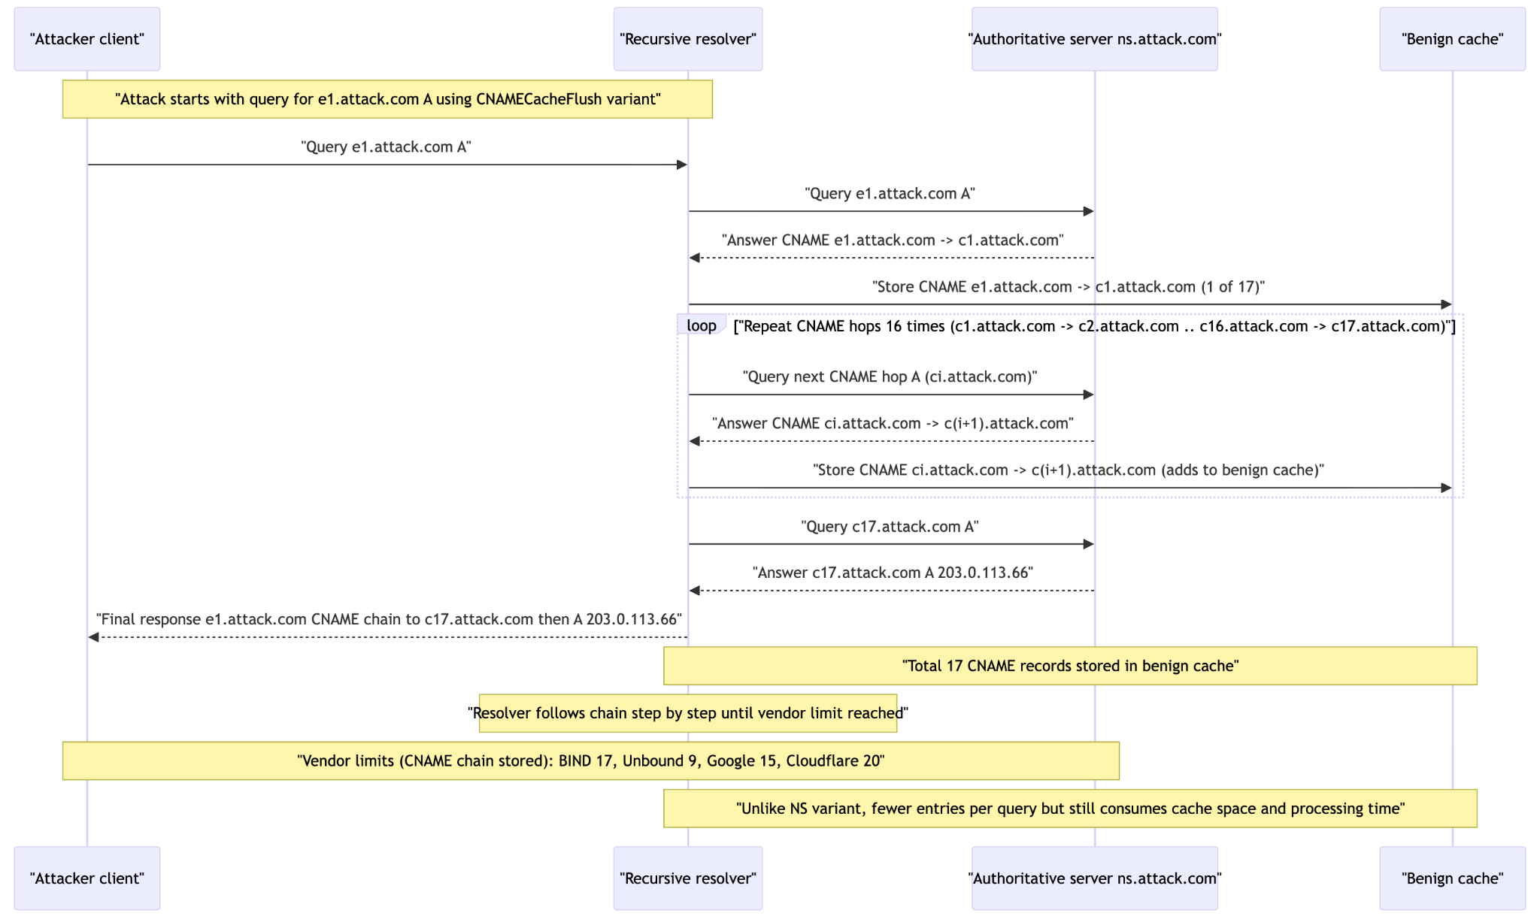
Example 2b: Prompt + Pcap

Slide 18
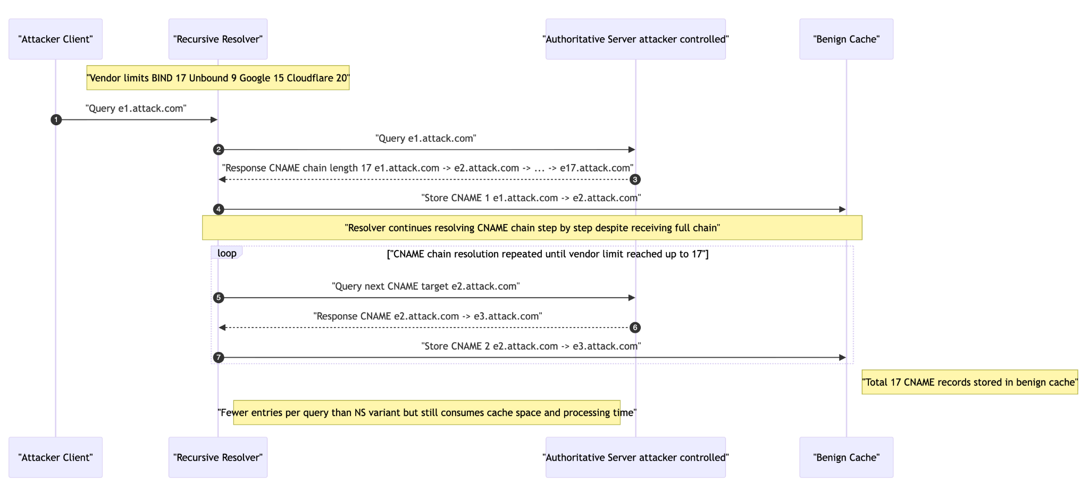
Example 2b: Prompt + Paper

Slide 19
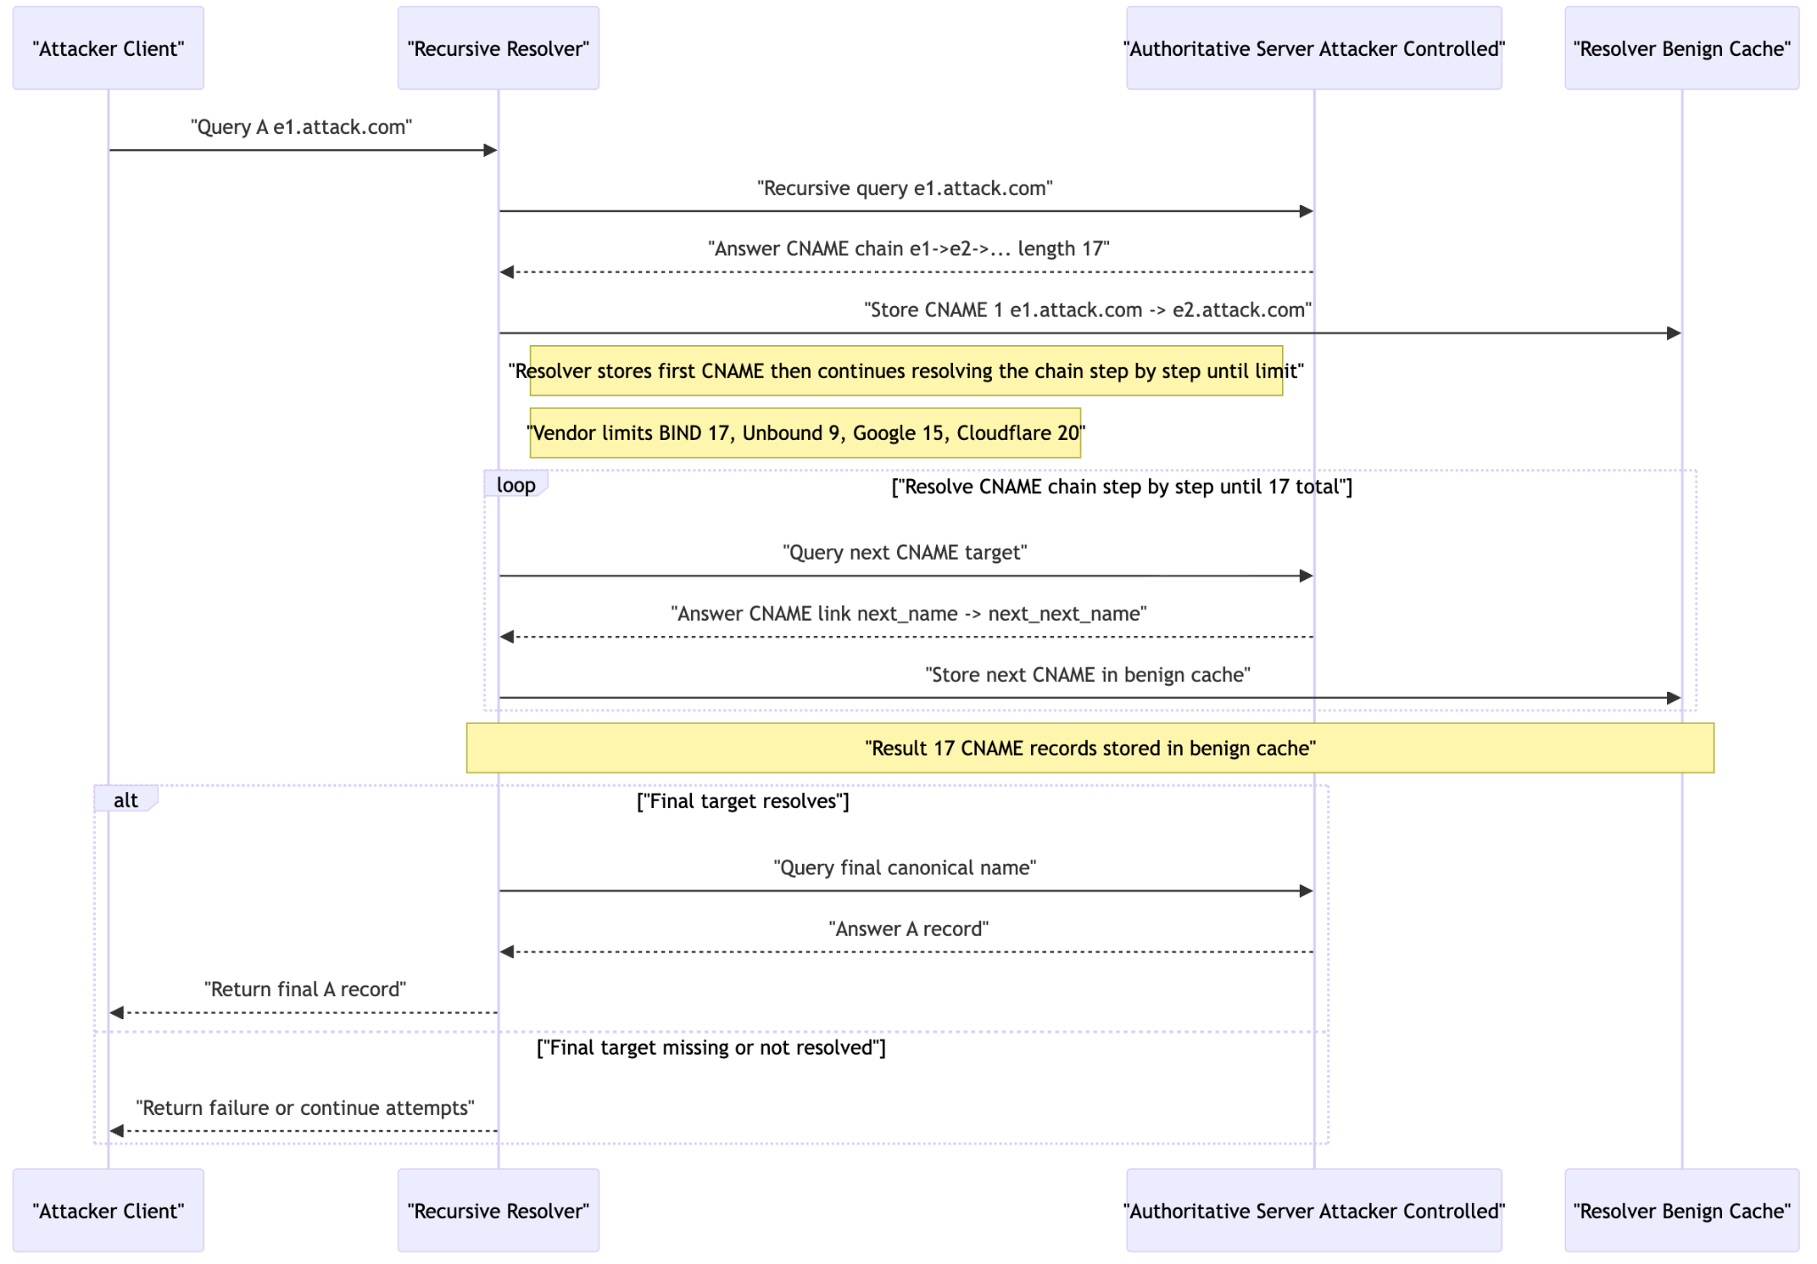
Example 2b: Prompt + Pcap + Paper

Slide 20
Original vs. Generated Diagrams
Original Figure
Purpose: A teaching schematic — explains the logic of the attack and resolver behavior.
Style: Step numbers, conceptual names (e1…e17), explicit “Store CNAME” annotations.
Scope: Emphasizes cache insertion, abstract chain length, not actual packets.
Differences in Generated Diagrams
pcap-only: Concrete DNS packets, sequential query/answer pairs, final A record with IP, less abstraction.
paper-only: Captures conceptual flow (e.g., store actions, cache effects), but lacks the packet trace detail — close to the original in purpose, but auto-generated and more machine-like.
pcap+paper: Hybrid view — combines abstraction (cache actions, conceptual labels) with concreteness (queries, CNAME answers, final IP). Sometimes adds alternate branches (failure handling) not in the original figure.

Slide 21
Generated Diagrams Compared
pcap-only vs. paper-only
pcap-only: Packet-level fidelity; good for evidence/debugging.
paper-only: Abstract reasoning; good for teaching/explaining attack mechanics.
Key difference: depth of detail vs clarity of intent.
pcap-only vs. pcap+paper
pcap-only: Shows what happened.
pcap+paper: Shows what happened and why (annotates cache actions, alternative paths).
Key difference: evidence vs explanation.
paper-only vs. pcap+paper
paper-only: Clean conceptual story, but misses concreteness.
pcap+paper: Rich, but can feel verbose or overloaded.
Key difference: simplicity vs completeness.

Slide 22
Conclusion
Helpful – auto-generates draft diagrams for new papers and slides
Strengths – combines packet evidence + protocol logic, saves authoring time
Refinement – export + chat interface enables manual polishing and iteration
Lacks – raw outputs less polished, sometimes visually dense
Overall – accelerates figure creation: quick drafts + easy refinement for academic use

